Slide 1
Climate Hack 2022
25 March 2022
UK Satellite Imagery Nowcasting
Wuhao, Horace, and Alby
Notes:
Introduce ourselves

Slide 2
Data Preprocessing
Climate Hack 2022
Compressed with JPEG
Cropped images to mainland UK
Filtered timestamps to 9am to 5pm
108GB -> 2GB
Implemented custom dataloader for faster loading time
Load 10 batches per second
1 batch = 16 sequences of 12+24 images
Notes:
Create our own dataset to account for lack of computing power
Cropped time, used JPEG
If more time, don’t compress to JPEG
Expand hours slightly

Slide 3
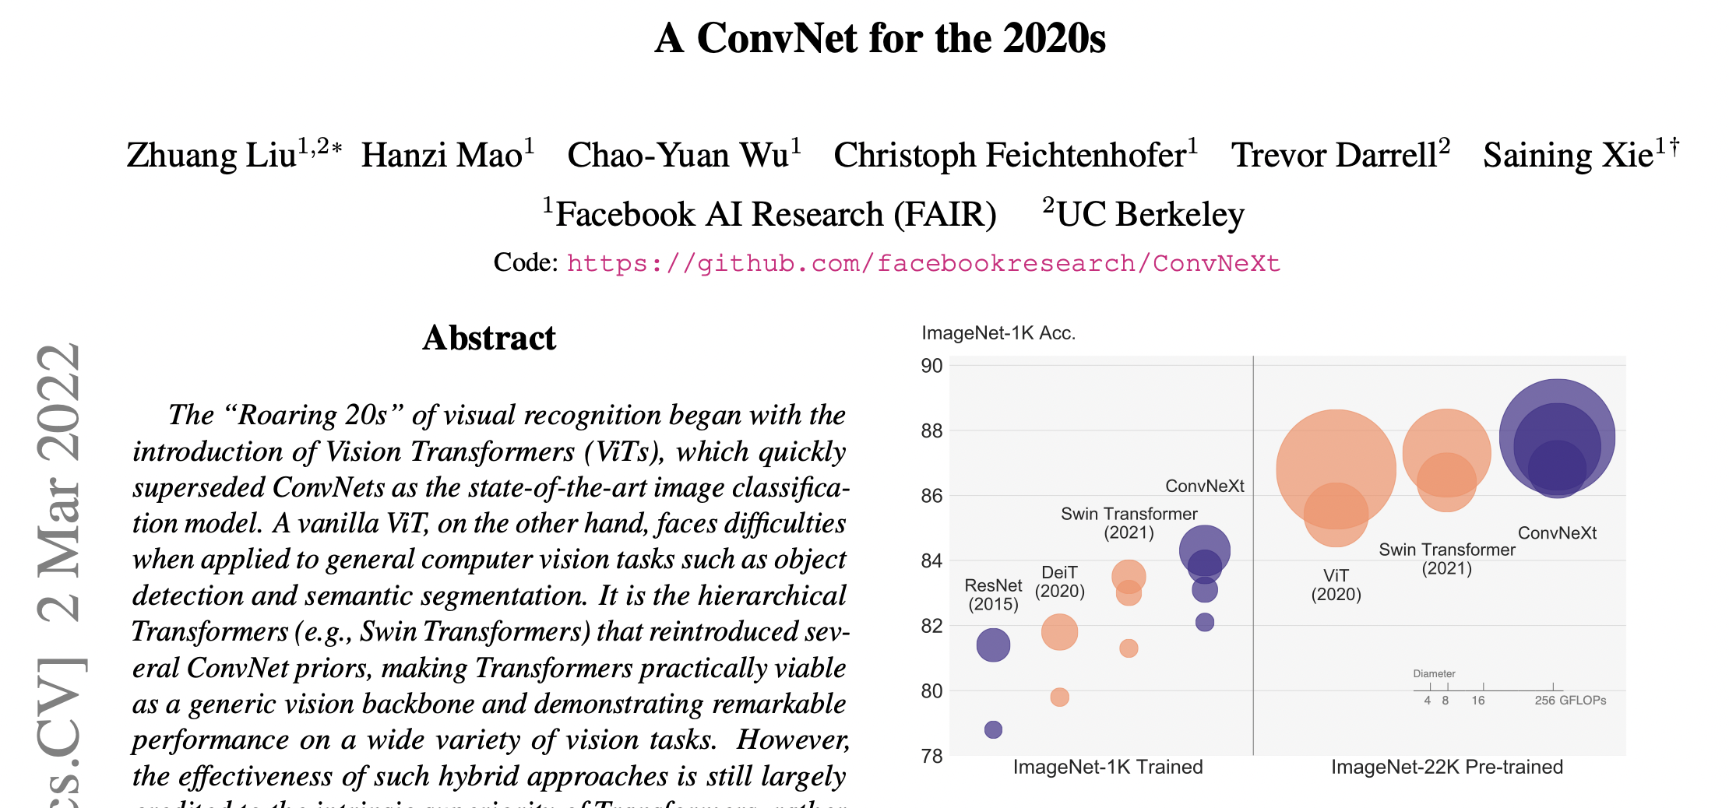
CNN Model
Climate Hack 2022
Autoencoder
5.2M parameters
Encoder: used first 4 blocks of ConvNeXt-T architecture
Simple and efficient architecture based on ResNet
Pretrained on ImageNet
Input: last 3 images of input sequence, concatenated as a single 3-channel image
Output: 24-channel image with each channel representing a different timestep
Achieves 0.777 score
https://arxiv.org/pdf/2201.03545.pdf

Slide 4
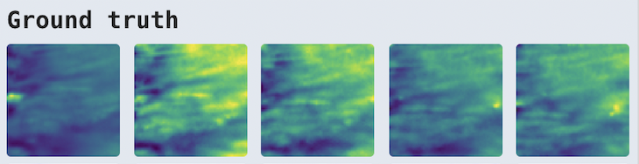
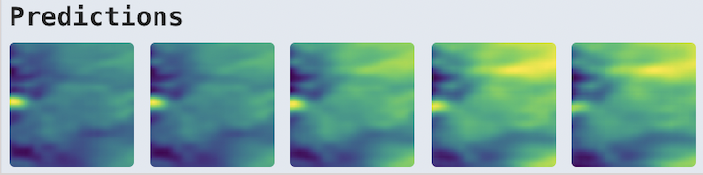
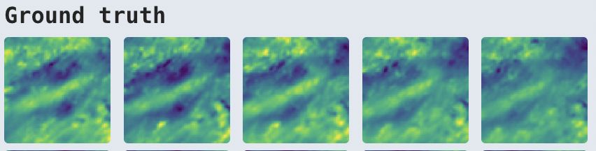
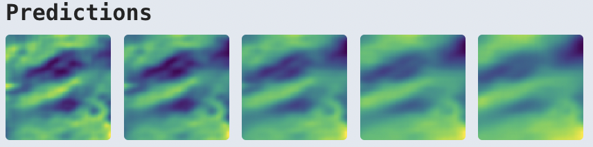
CNN Model
Climate Hack 2022
Example predictions

Slide 5
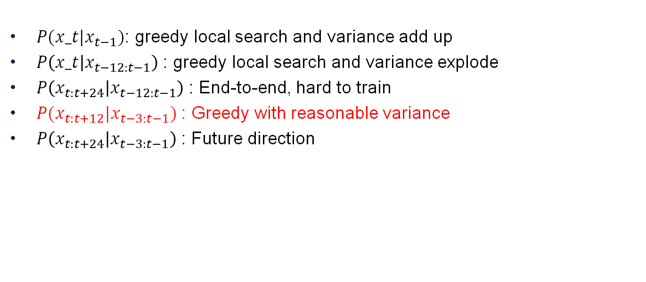
The choice of density function
Climate Hack 2022
$P(x_t|x_{t−1})$: greedy local search and variance add up
$P\left(x_t | x_{t−12:t−1}\right)$ : greedy local search and variance explode
$P\left(x_{t:t+24} | x_{t−12:t−1}\right)$ : End-to-end, hard to train
$P(x_{t:t+12}|x_{t−3:t−1})$ : Greedy with reasonable variance
$P\left(x_{t:t+24} | x_{t−3:t−1}\right)$ : Future direction

Slide 6
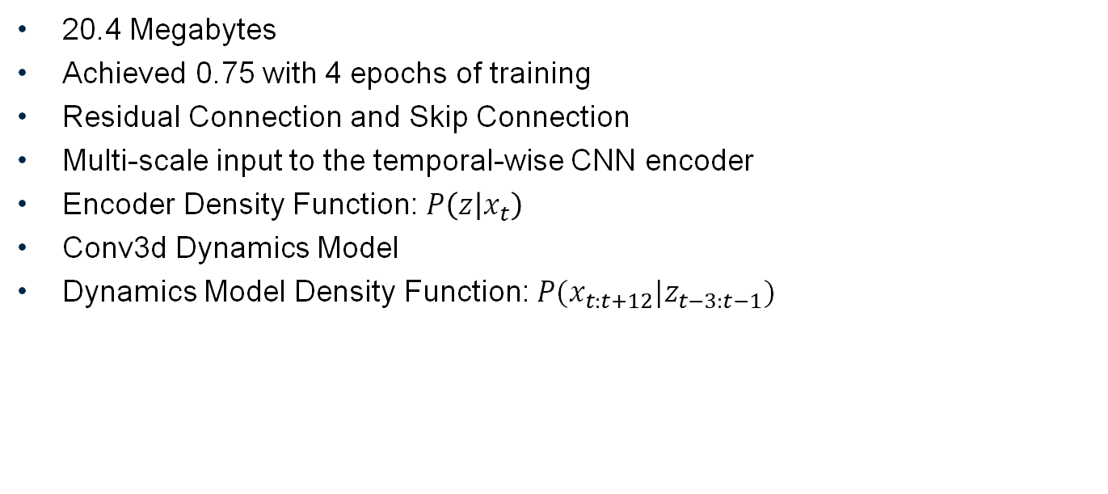
Model (x-small)
Climate Hack 2022
20.4 Megabytes
Achieved 0.75 with 4 epochs of training
Residual Connection and Skip Connection
Multi-scale input to the temporal-wise CNN encoder
Encoder Density Function: $P\left(z | x_{t}\right)$
Conv3d Dynamics Model
Dynamics Model Density Function: $P(x_{t:t+12}|z_{t−3:t−1})$

Slide 7
Loss Function
Climate Hack 2022
Time Weighted MSE with MS-SSIM
Loss = alpha * Time Weighted MSE + gamma * MS-SSIM
Improve Quality of the Model

Slide 8
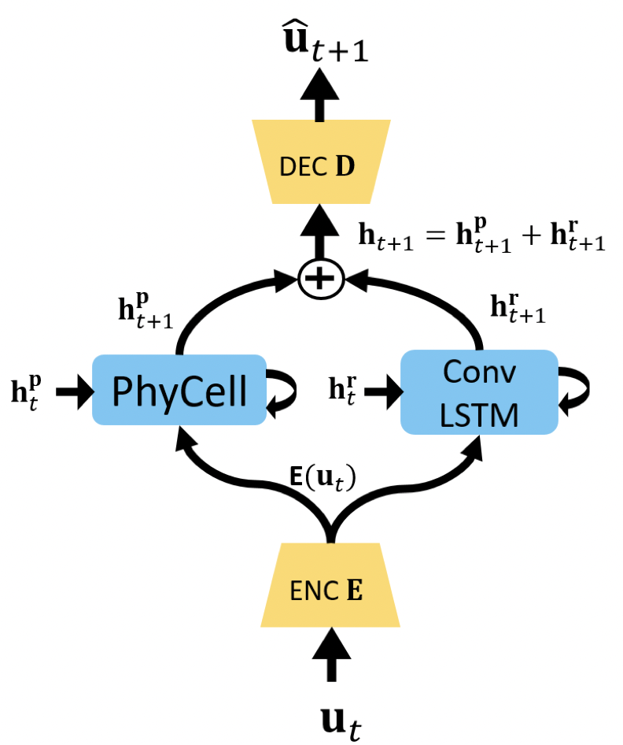
Other architectures we tried
Climate Hack 2022
PhyDNet (https://arxiv.org/abs/2003.01460)
Achieved score of 0.72
Vision Transformer-based model
Achieved score of 0.62
Optical Flow
Achieved score of 0.70
Notes:
Exams
GPU - K80

Slide 9
Limitations
Climate Hack 2022
Time
Computational Power
Not equivariant to warping!
Notes:
Exams
GPU - K80

Slide 10
Future Directions
Climate Hack 2022
Make CNN equivariant to warping and other possible transformations
Adversarial Training like GAN
Input augmentation
Hyperparameters Tuning
Use Uncompressed Raw Data
Notes:
Exams
GPU - K80

Slide 11
Thank you!
Climate Hack 2022

